Slide 1
Educational Institutions Management & Monitoring System
Name Student ID
Kamrul Hasan Shourov 1005097
Mahabub Zoraf 1005106
Aminul Haque Ripon 1005107
Md. Bulbul Sharif 1005108
Ashif Salman Rupsha 1005109

Slide 2
Educational Institutions Management & Monitoring System
Sub Systems:
1. Registration for Primary School Certificate Examination.
2. Monitoring Student’s Performance.
3. Monitoring Teacher’s Performance.
4. Monitoring Institution’s Performance.
5. Book Distribution.

Slide 3

1. Registration for Primary School Certificate Examination
Description of the Sub-System
Every year student list is given to Upazilla Education Office.
Upazilla Education Offices send their lists to Ministry
of primary and mass education.
Then Ministry completes the registration process.

Slide 4
Problems of existing system
As it is done manually, a lot of manpower is needed.
Naturally a lot of mistakes occur
Sometimes schools need to submit the list for more than one time.

Slide 5
Worthiness of proposed system
This system will reduce the problems occurred because of being manual.
Error checking and recovery will be much easier.
Less manpower will be needed.
Management and monitoring will be much more better.

Slide 6
Roadblocks of proposed system
There are a lot of primary schools in many remote areas.
These schools will face problems to complete online registration.

Slide 7

2. Monitoring Teacher’s Performance
A teacher must have strong educational background.
They must be trained to improve their teaching quality.

Slide 8
Problems of existing subsystem
Can’t found who needs training.
To select the trainee, lobbing becomes the main factor.
Many teachers enjoy training session as no one
Will monitor them later.

Slide 9
Scope of Proposed automated system
The list of trainee can be made by analyzing the profiles of teachers.

Slide 10
Worthiness of proposed system
If teacher’s performance is improved, then student’s performance
Will also be improved.
Every teacher will be under monitoring.
Unnecessary training sessions will be eliminated.

Slide 11
Roadblocks of proposed system
There may be some wrong information provided by the institution.

Slide 12

3. Monitoring Student’s Performance
Existing subsystem
Sometimes examination result and attendance report of
Students are taken by education controlling offices.

Slide 13
Problems of existing subsystem
Education controlling offices don’t take any effective step

Slide 14
Scope of Proposed automated system
Result of every semester examination of all students of an institution
Will be uploaded to the system.
Attendance report will also be uploaded in every week.

Slide 15
Worthiness of proposed system
This will be helpful to take proper steps to improve students performance.
As result and attendance will be centrally monitored , there will be significant
improvement in students performance.

Slide 16

4. Monitoring Institution’s Performance
Scope of subsystem
Institutions performance mainly depends on-
1.Number of specialized teachers.
2.Laboratories facilities
3.Teacher-student ratio.
4.Distribution of classes among proper teachers

Slide 17
Worthiness of proposed system
Teacher-student ratio will be analyzed.
Number of specialized teachers will always be under observation.
Condition of laboratories will be ranked by an invigilator uploaded to respective
Institutions’ account.

Slide 18
Roadblocks of proposed system
Here, concept of invigilator for laboratories is still manual.
Wrong information may be served by the invigilator.

Slide 19
5. Book Distribution
Existing subsystem
List of students are taken by the Upazilla Education Office and
Upazilla Secondary Education Office from the respective educational
Institutions.
This lists are given to ministry and from the ministry the Textbook Board
Gets the list and publishes the required number of books.
The books are distributed to schools by the Upazilla Education Office and Upazilla
Secondary Education Office.

Slide 20
Problems of existing subsystem
If the information provided by the institutions are wrong then more books
Are needed to be printed.
Sometimes books are sold in black market.
Book distribution process is also brings a lot of harassments to the institutions.

Slide 21
Worthiness of proposed system
As every institution must give its student list to the account, textbook board
Will have a clear idea about required number of books.
The tradition of selling books in black market will end.
Necessity of printing extra books will be eliminated.

Slide 22
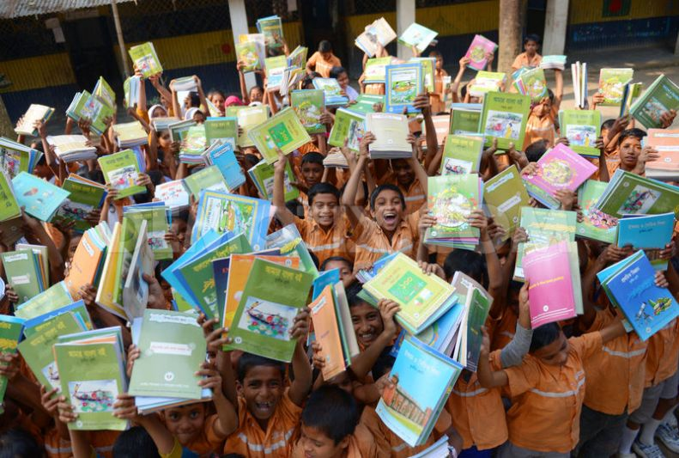

Slide 23


